Slide 1
How to Manage Conflict
Life of a Student Athlete
By: Craig Huff

Slide 2
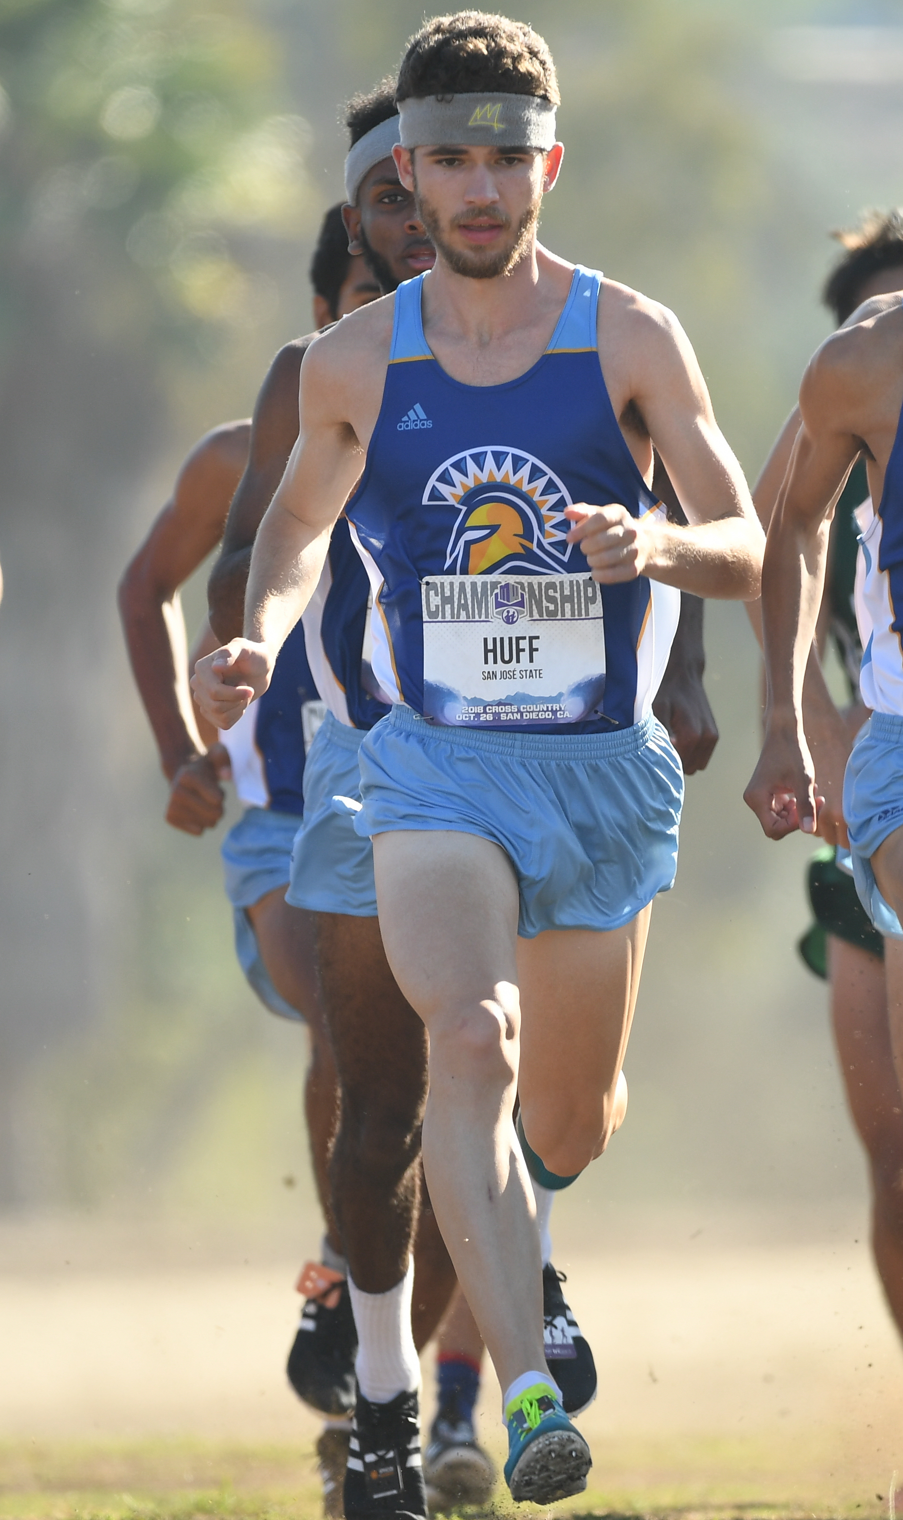
About Myself
Computer Science Major
5th Year Men’s Cross Country/Track Athlete
NCAA All-American Academic
3x Mountain West Scholar Athlete
Software Engineer at Direct Athletics

Slide 3
What Is Conflict?
Conflict is a problematic situation that occurs between interdependent people who seek different goals or means to those goals.

Slide 4


Common Sources of Conflict
Team Related Events
Roommates
Classes
Work

Slide 5
Conflict Resolution Skills
Communication
Stress Management
Forgivness
Mediation

Slide 6
Important Resources
Ombudspersons
Coaches
Teachers
Department Chairs’
Major Advisors
Athletic Academic Advisors
Athletic Director
Compliance Office
Resident Advisors

